Slide 1
High-precision measurement of the neutron EDM
Construction and characterization of the main B₀ magnet for the nEDM@SNS experiment
Alexandra Klipfel
Faculty advisor: Brad Filippone

Slide 2
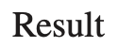
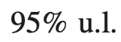
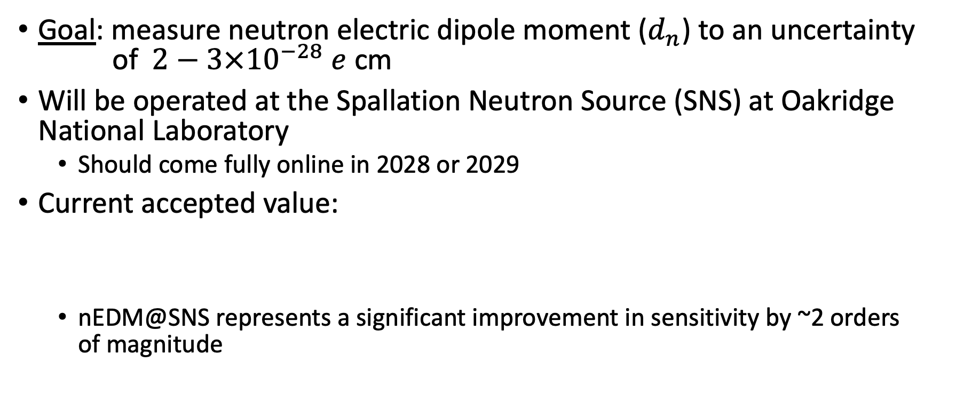
Overview of nEDM@SNS
Goal: measure neutron electric dipole moment ($d_{n}$) to an uncertainty of $2−3×{10}^{−28} e$ cm
Will be operated at the Spallation Neutron Source (SNS) at Oakridge National Laboratory
Should come fully online in 2028 or 2029
Current accepted value:
nEDM@SNS represents a significant improvement in sensitivity by ~2 orders of magnitude
(Pendlebury et al. 2015, Phys. Rev. D)
Notes:
And a little later on I will address why this is the case and how we expect to increase the precision so dramatically

Slide 3
Motivation
Long history of searches for EDMs of various particles, nuclei, and molecules
~60 years of history for nEDM measurements
Goal: explore and test Beyond Standard Model (BSM) theories
Proposed BSM scenarios address issues like dark matter and the baryonic asymmetry of the universe
These theories provide new, unobserved mechanisms of CP violation which generate EDMs
Thus, the observation of EDMs would indicate the existence of these CP violating mechanisms and lend support to BSM theories
Notes:
So, therefore if we want to probe beyond the standard model and search for evidence of these theories, this is a very important realm of experimentation.

Slide 4
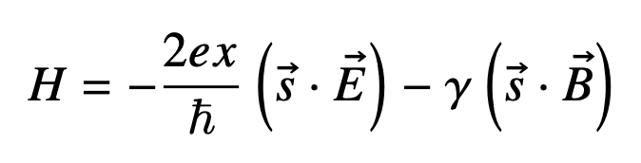
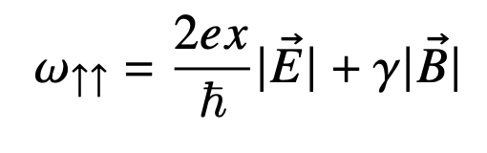
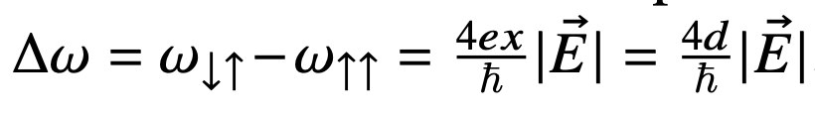
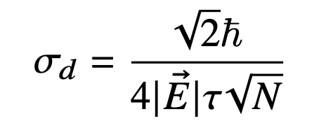
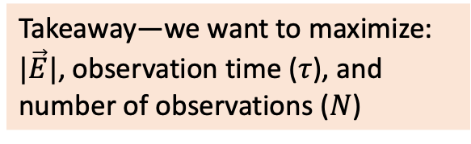
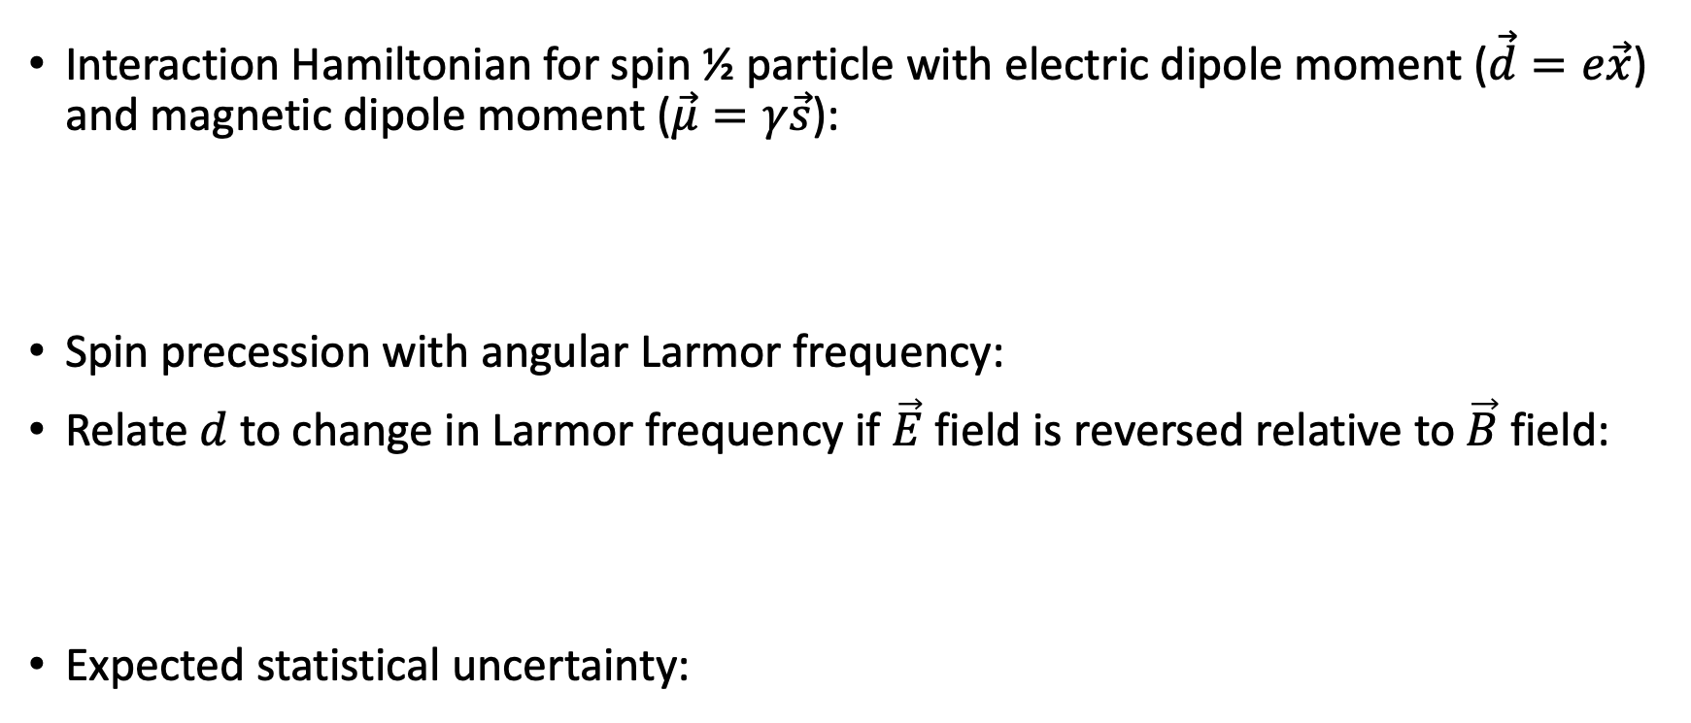
nEDM@SNS Methods
Interaction Hamiltonian for spin ½ particle with electric dipole moment ($\vec{d}=e\vec{x}$) and magnetic dipole moment ($\vec{μ}=γ\vec{s}$):
Spin precession with angular Larmor frequency:
Relate $d$ to change in Larmor frequency if $\vec{E}$ field is reversed relative to $\vec{B}$ field:
Expected statistical uncertainty:
Takeaway—we want to maximize: $|\vec{E}|$, observation time ($τ$), and number of observations ($N$)
Notes:
in this case "parallel" indicates that the electric field is parallel to the magnetic field.
I am going to explain how the nEDM@SNS experiment prpposes to maximize these three quantities.

Slide 5
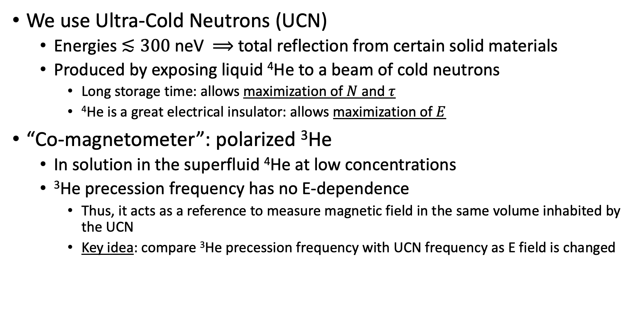
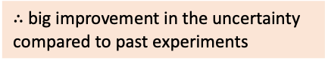
nEDM@SNS Methods
We use Ultra-Cold Neutrons (UCN)
Energies $≲300$ neV $⟹$ total reflection from certain solid materials
Produced by exposing liquid ⁴He to a beam of cold neutrons
Long storage time: allows maximization of $N$ and $τ$
⁴He is a great electrical insulator: allows maximization of $E$
“Co-magnetometer”: polarized ³He
In solution in the superfluid ⁴He at low concentrations
³He precession frequency has no E-dependence
Thus, it acts as a reference to measure magnetic field in the same volume inhabited by the UCN
Key idea: compare ³He precession frequency with UCN frequency as E field is changed
$∴$big improvement in the uncertainty compared to past experiments
Notes:
Acts as a co-magnetometer because it allows us to measure the magnetic field in the volume occupied by the neutrons.
3He has negligible E dependence—EDM is screened by atomic electrons

Slide 6
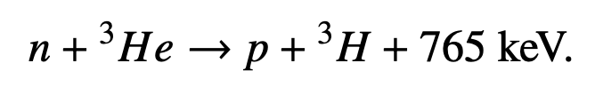
nEDM@SNS Methods
³He absorbs UCN, causes ⁴He to produce measurable UV scintillation light
Absorption cross-section (and therefore scintillation rate) is highly spin-dependent
Maximized when the spins are antiparallel
Thus, scintillation rate depends on Larmor frequencies of ³He and UCN
Changing the E field should result in a change to the UCN frequency, and therefore a change in the scintillation rate that is directly related to the neutron’s EDM value
Key takeaway: We measure the UV scintillation intensity for different applied electric fields and from this, we can extract the value of the nEDM
Notes:
Measure the scintillation light with a wavelength-shifting dye that coats the neutron-impermeable walls of the UCN storage chambers

Slide 7
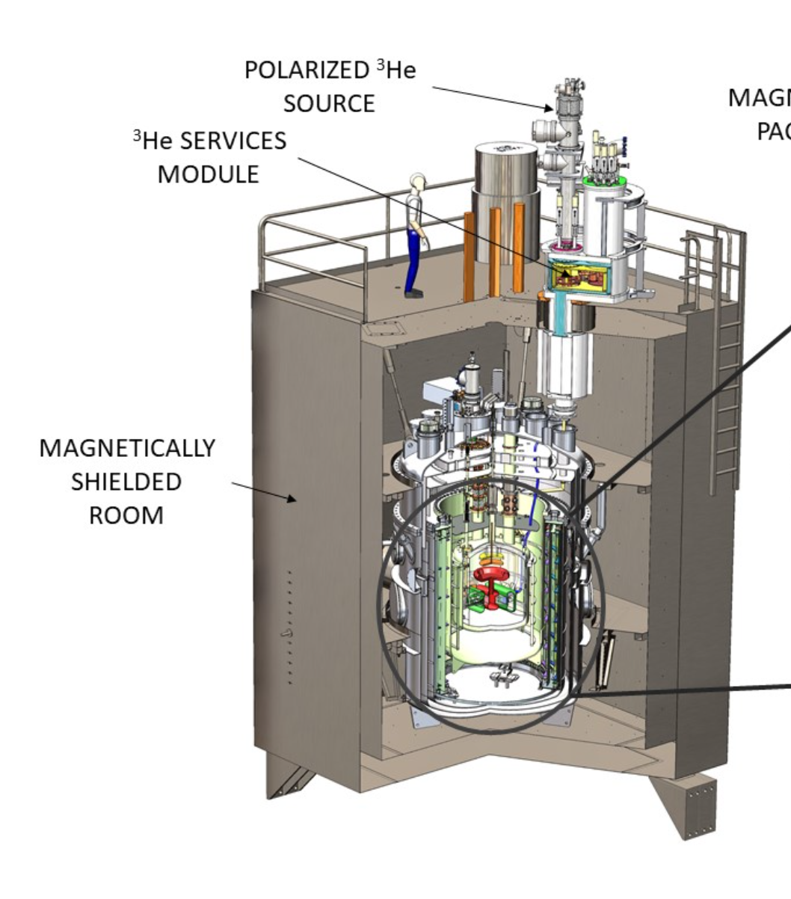
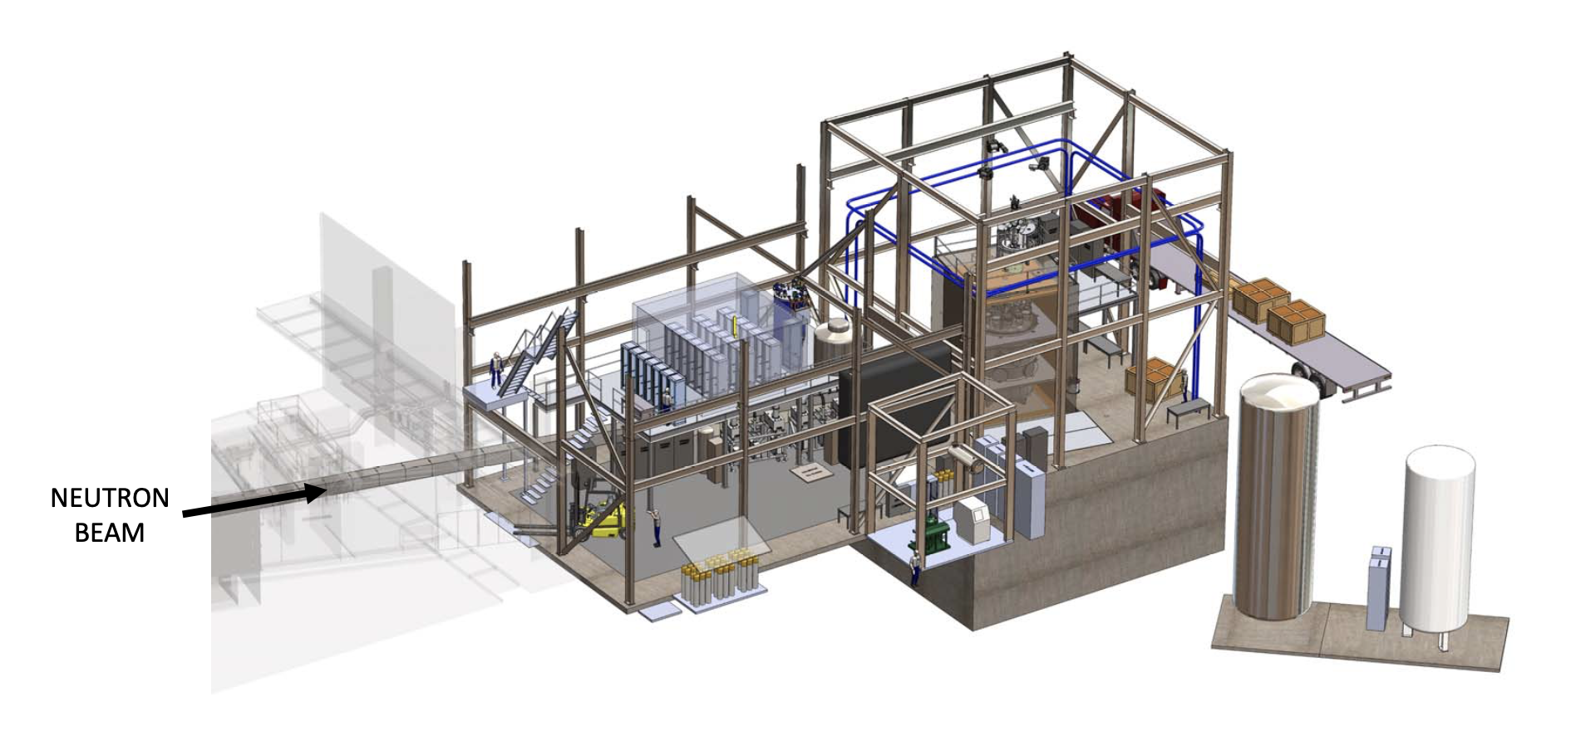
Breakdown of Experiment
CRYO-VESSEL
Ahmed et al. 2019, JINST
Notes:
Components are being built at several universities
Experiment will be assembled and run at Oakridge National Labs

Slide 8
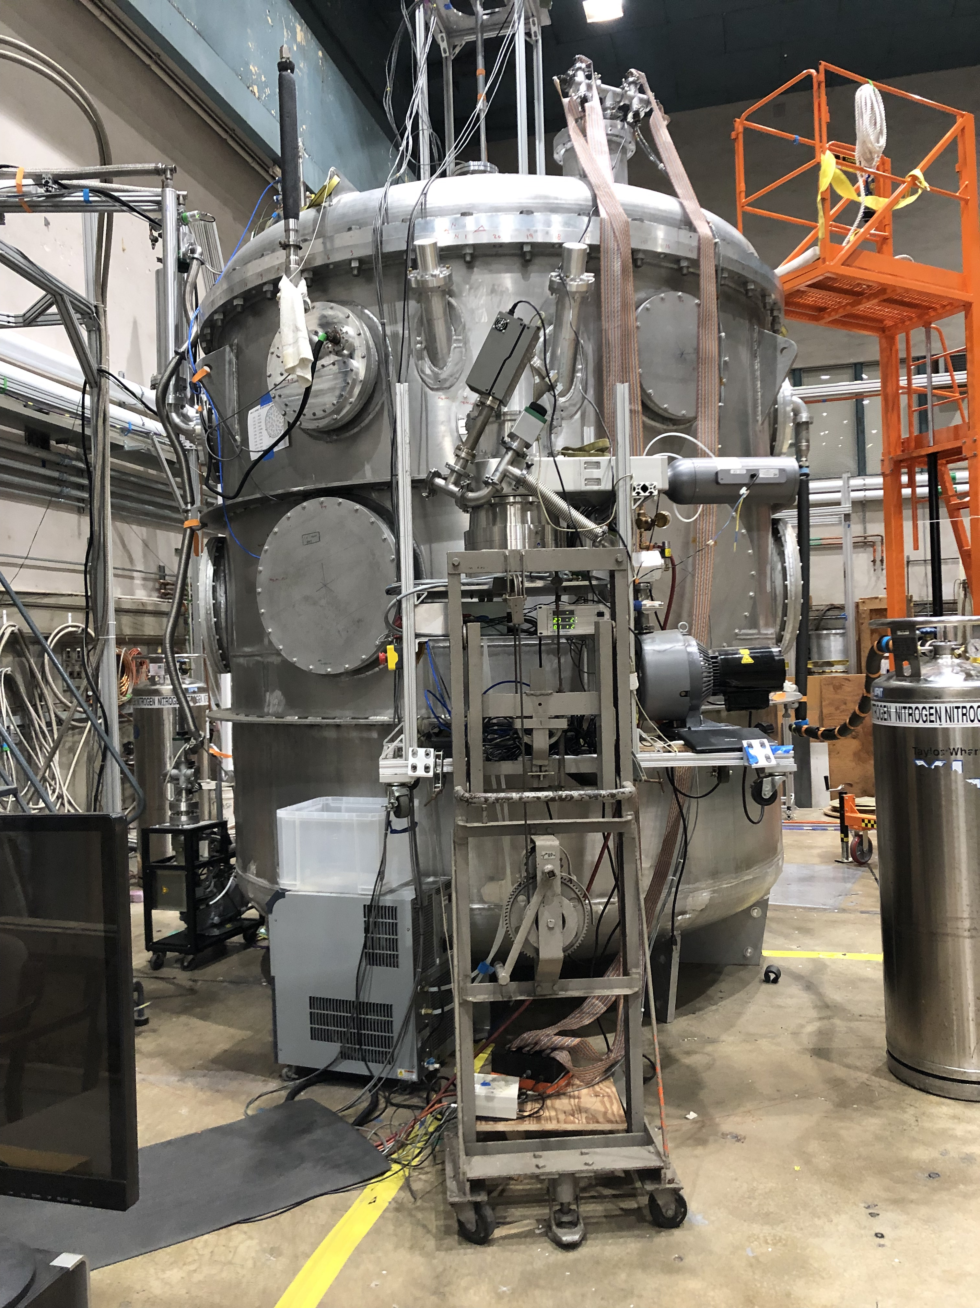
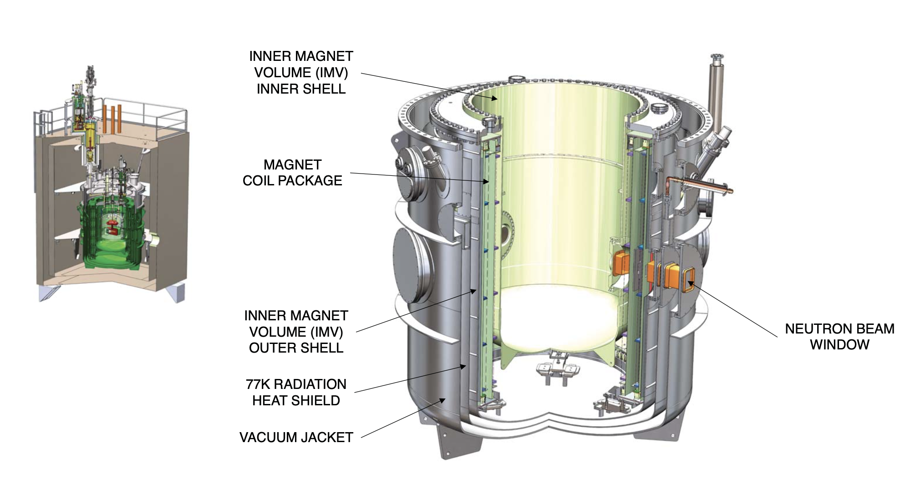
Caltech’s Role
Prof. Filippone’s group is constructing and testing the cryogenic vessel and B₀ magnet system
Cryo-vessel: will house the two measurement cells, detectors, magnet systems, shielding…
Cools everything < 7 K
Ahmed et al. 2019, JINST
Notes:
Lead goes superconducting at ~7.2K
The vessel is ~15-20 feet high

Slide 9
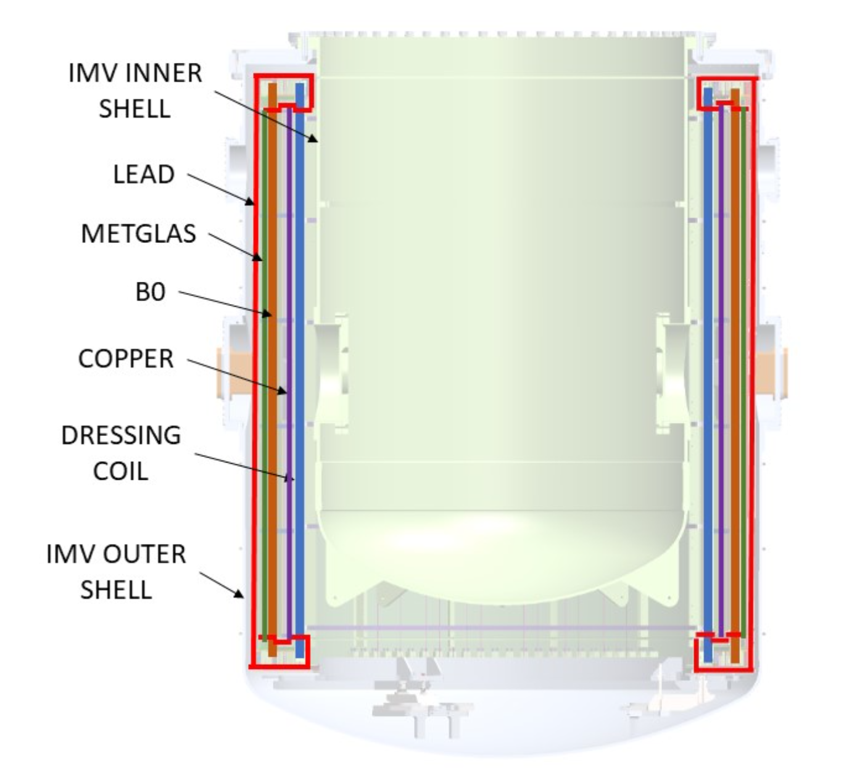
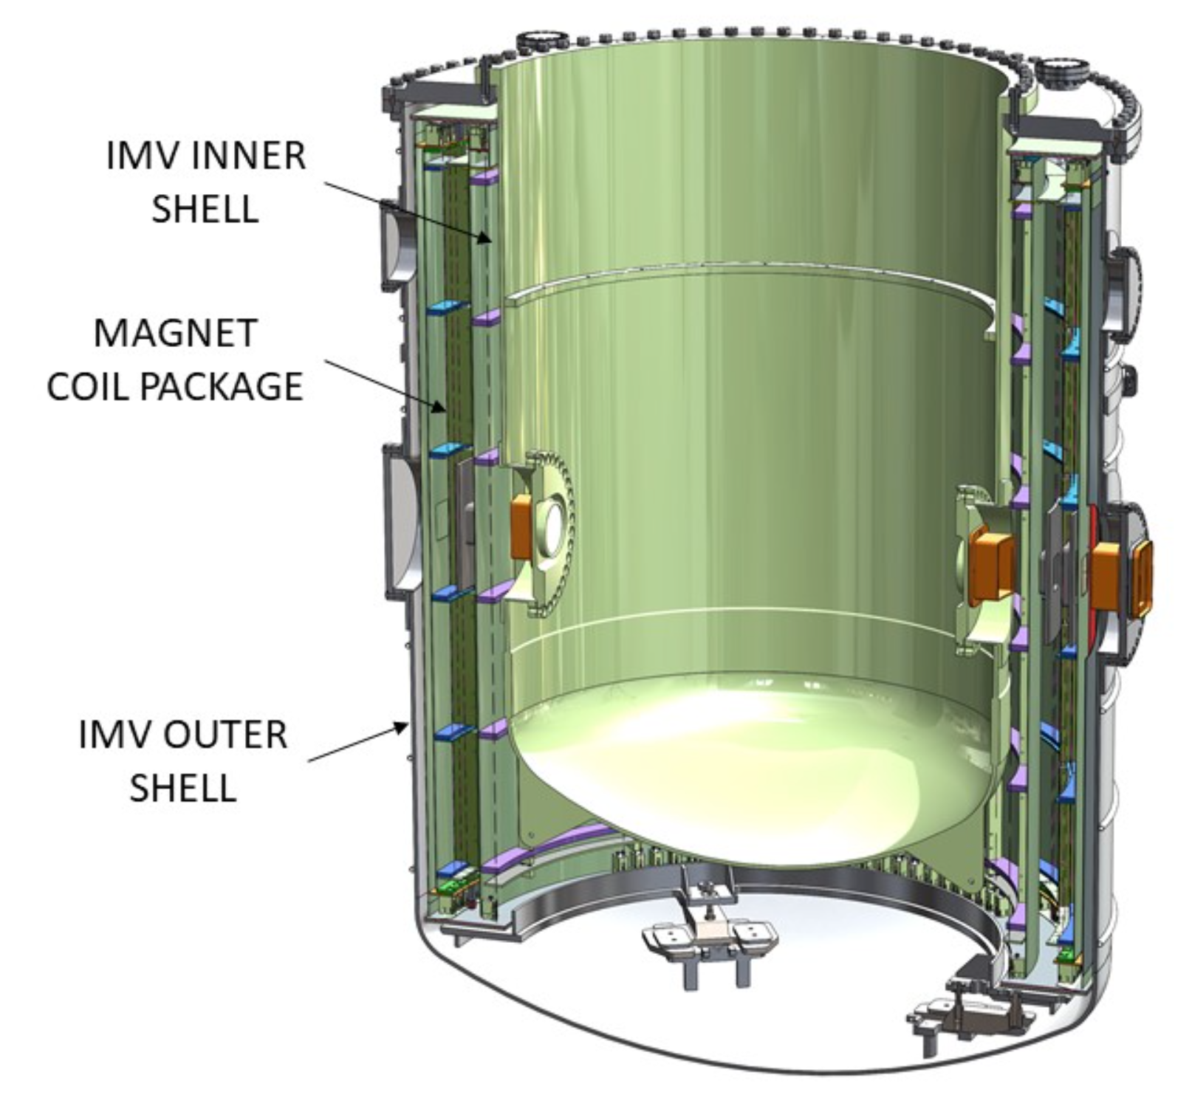
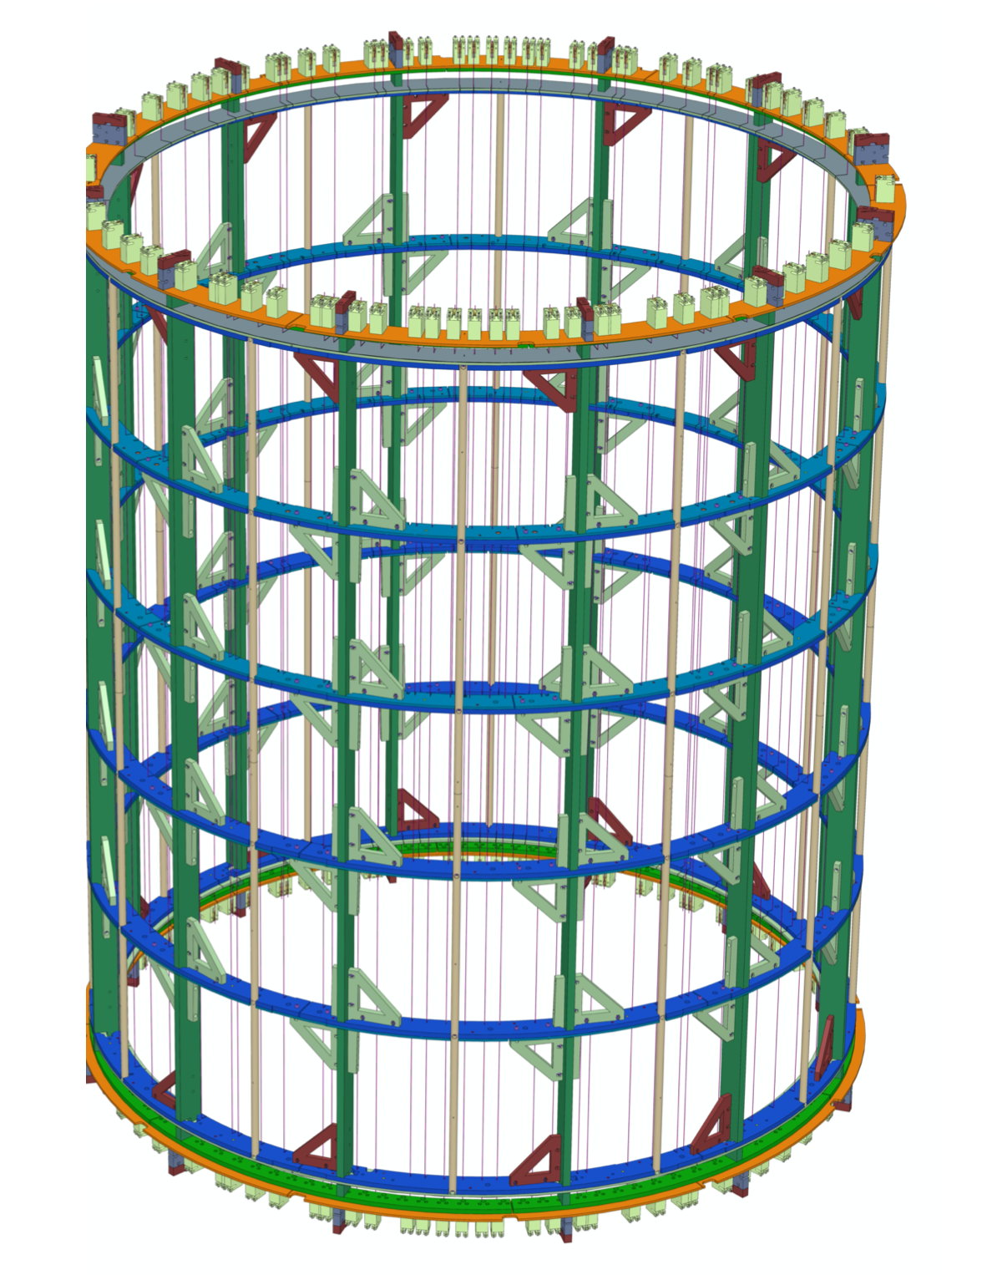
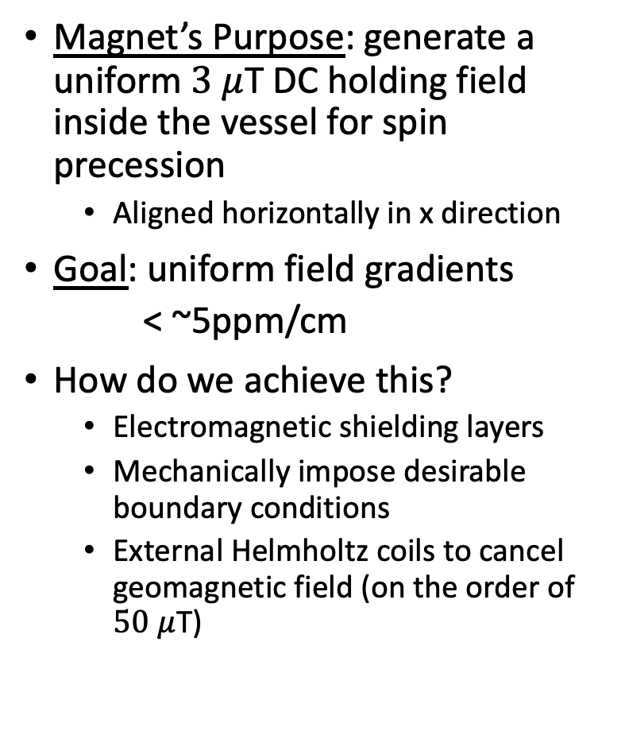
My specific project: B₀ magnet
Cross-cut of cryo-vessel
Magnet’s Purpose: generate a uniform $3 μ$T DC holding field inside the vessel for spin precession
Aligned horizontally in x direction
Goal: uniform field gradients
< ~5ppm/cm
How do we achieve this?
Electromagnetic shielding layers
Mechanically impose desirable boundary conditions
External Helmholtz coils to cancel geomagnetic field (on the order of $50 μ$T)
B₀ MAGNET AND SHIELDING LAYERS
B₀ magnet coil schematic
Ahmed et al. 2019, JINST
Notes:
So the B0 magnet is one of the magnet coils that sits inside the cryo-vessel
other coils are AC for field
manipulation
All the shielding and coils are nestled in the cryo-vessel like layers of an onion

Slide 10
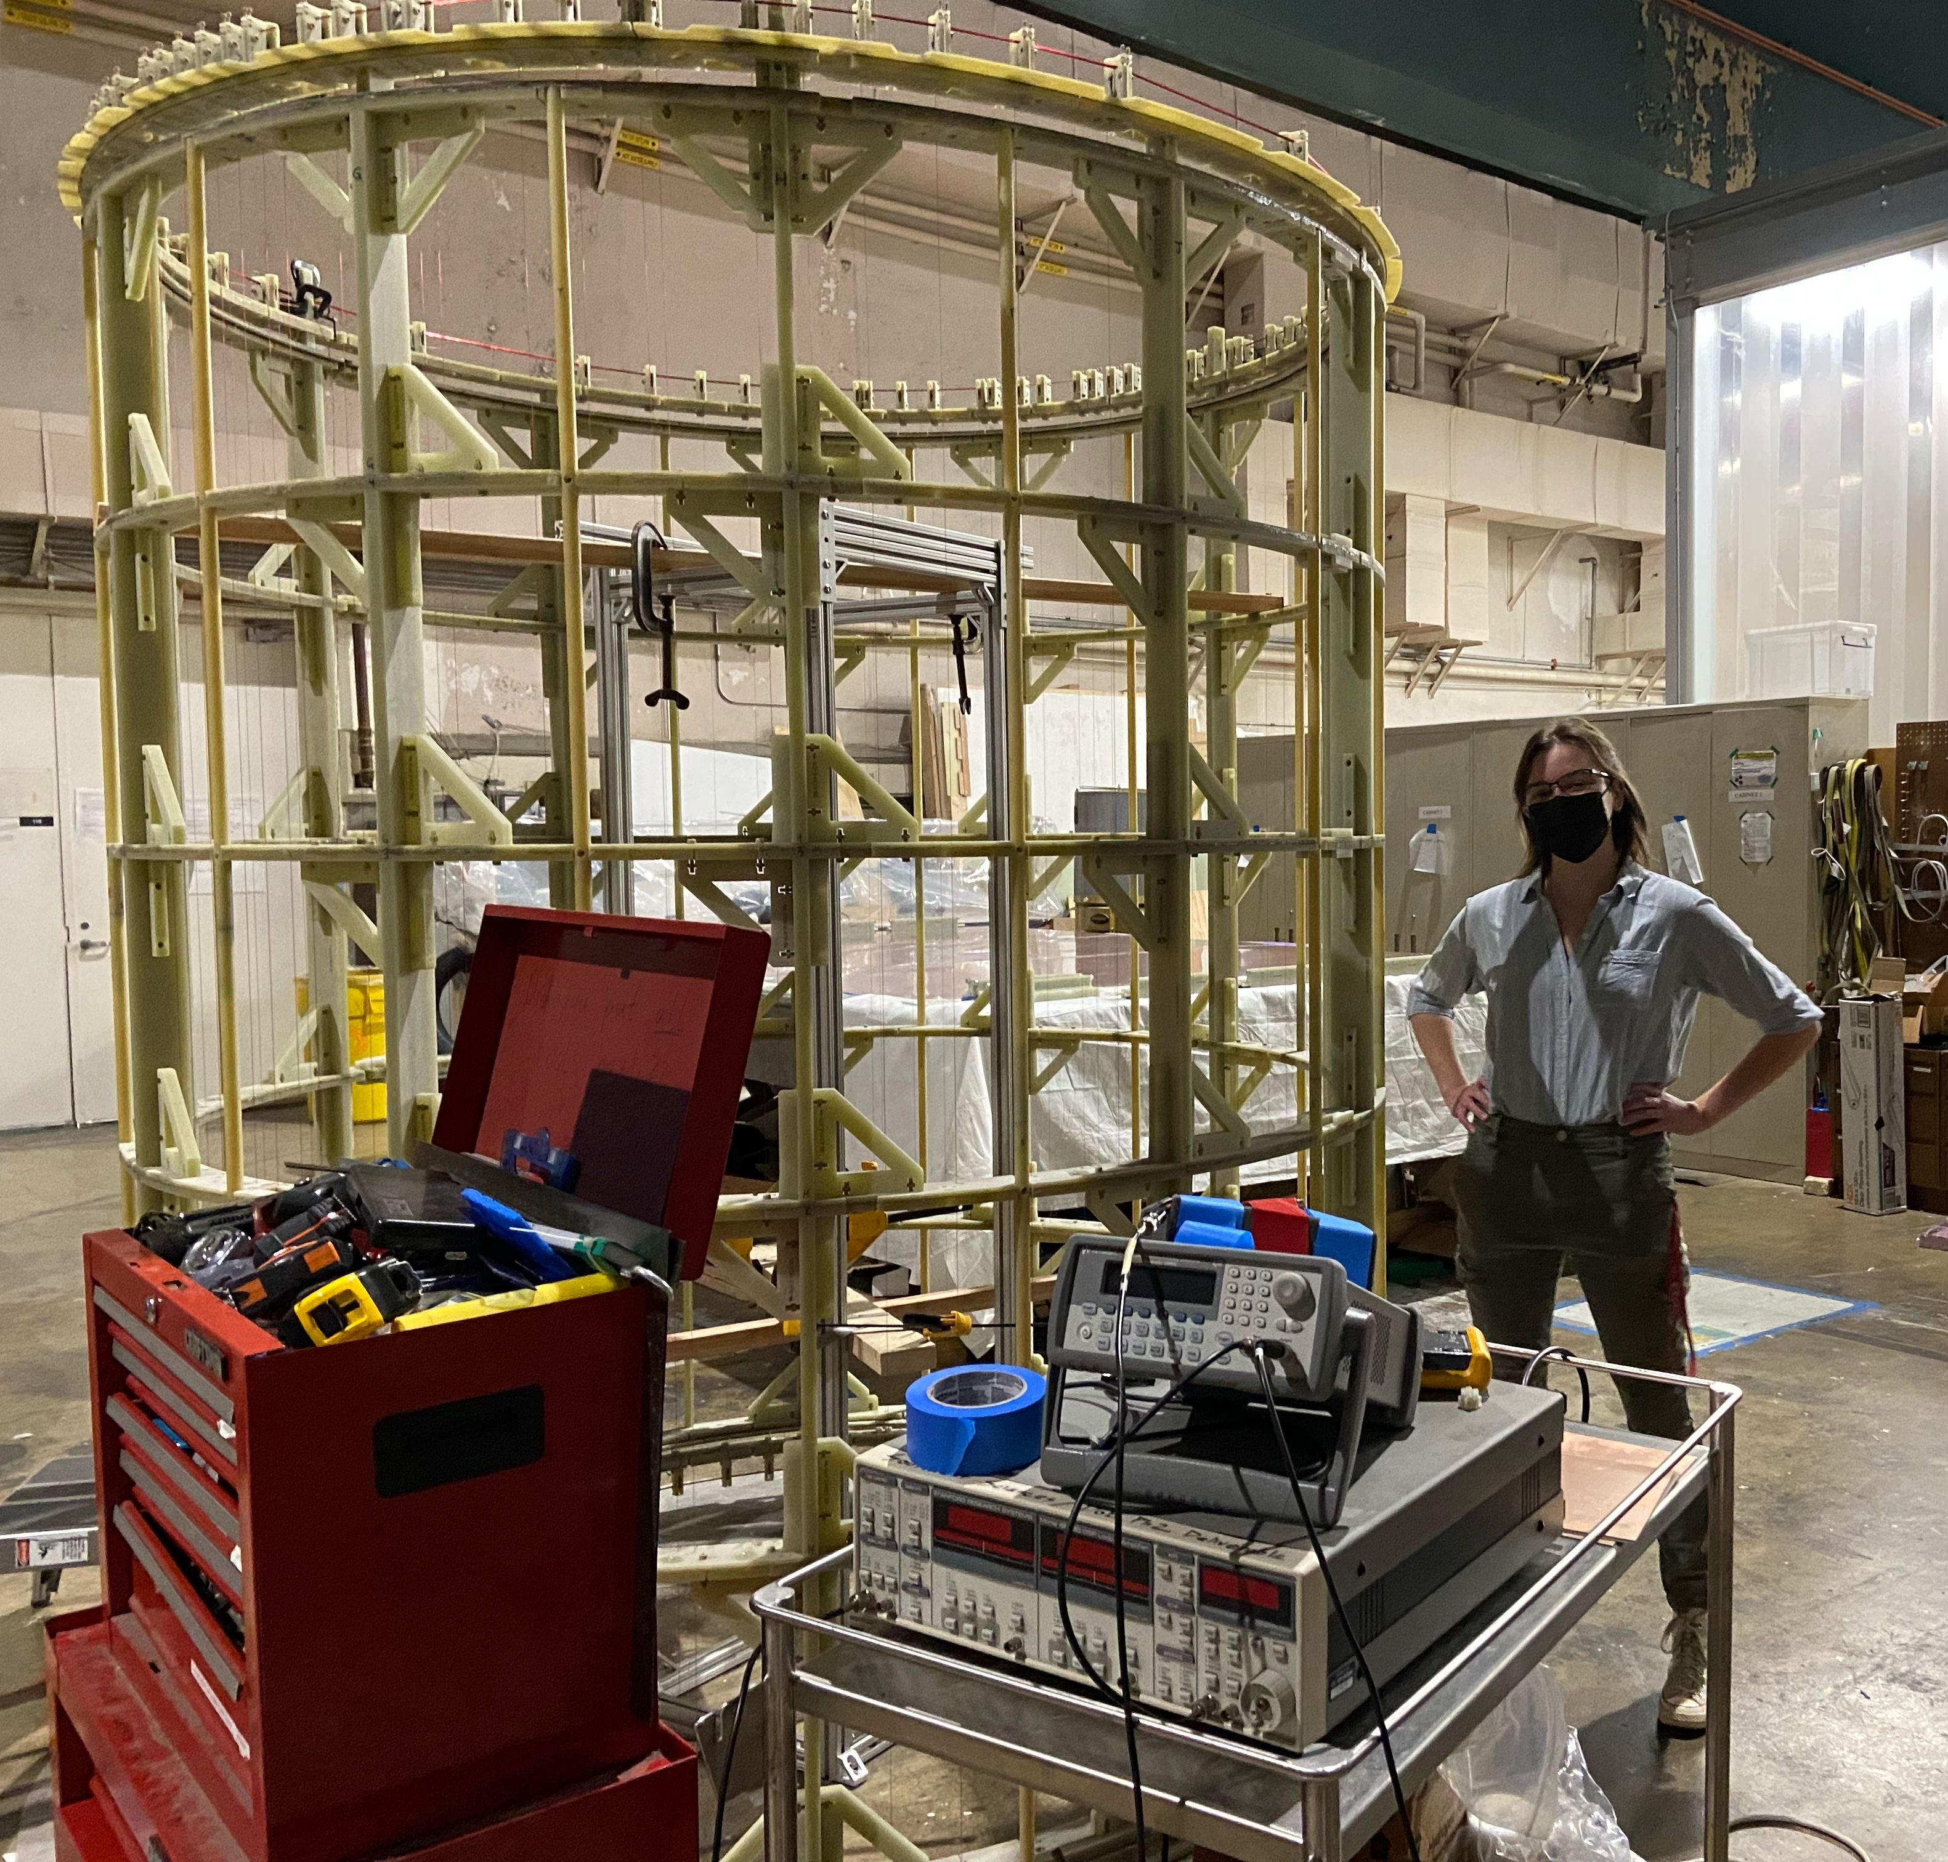
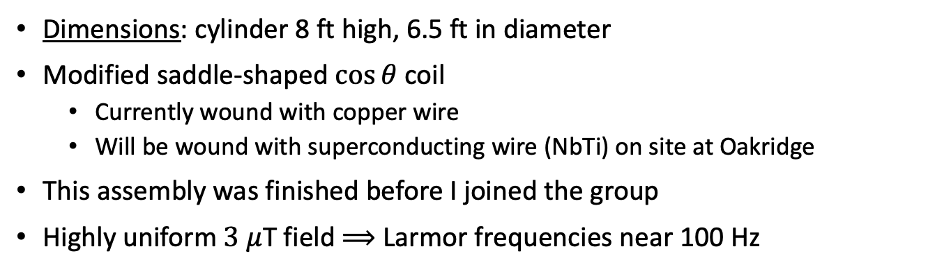
Timeline
Construction
Assemble G10 frame
Wind copper wire coil
Lead shielding panels
Copper-coated G10 panel
Metglas shield
Superconducting lead endcaps
Insert into cryovessel
Test vacuum and cooling systems
Characterization
Measurement campaign #1
Remove magnet and make any required fixes
Measurement campaign #2
Pack and Ship to Oakridge
B₀ magnet frame and coil
Dimensions: cylinder 8 ft high, 6.5 ft in diameter
Modified saddle-shaped $\cos{θ}$ coil
Currently wound with copper wire
Will be wound with superconducting wire (NbTi) on site at Oakridge
This assembly was finished before I joined the group
Highly uniform $3 μ$T field $⟹$ Larmor frequencies near 100 Hz
Ahmed et al. 2019, JINST
Notes:
We want uniformity for two reasons:
1. to maintain the polarization of the neutrons and 3He atoms
2. to minimize a systematic false EDM signal that’s induced by motional magnetic field effects
What is G10—a fiberglass material
-can control which directions thermal contraction occurs therefore when this gets cooled the components shrink in a uniform way we understand

Slide 11
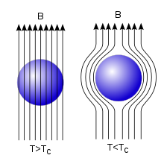
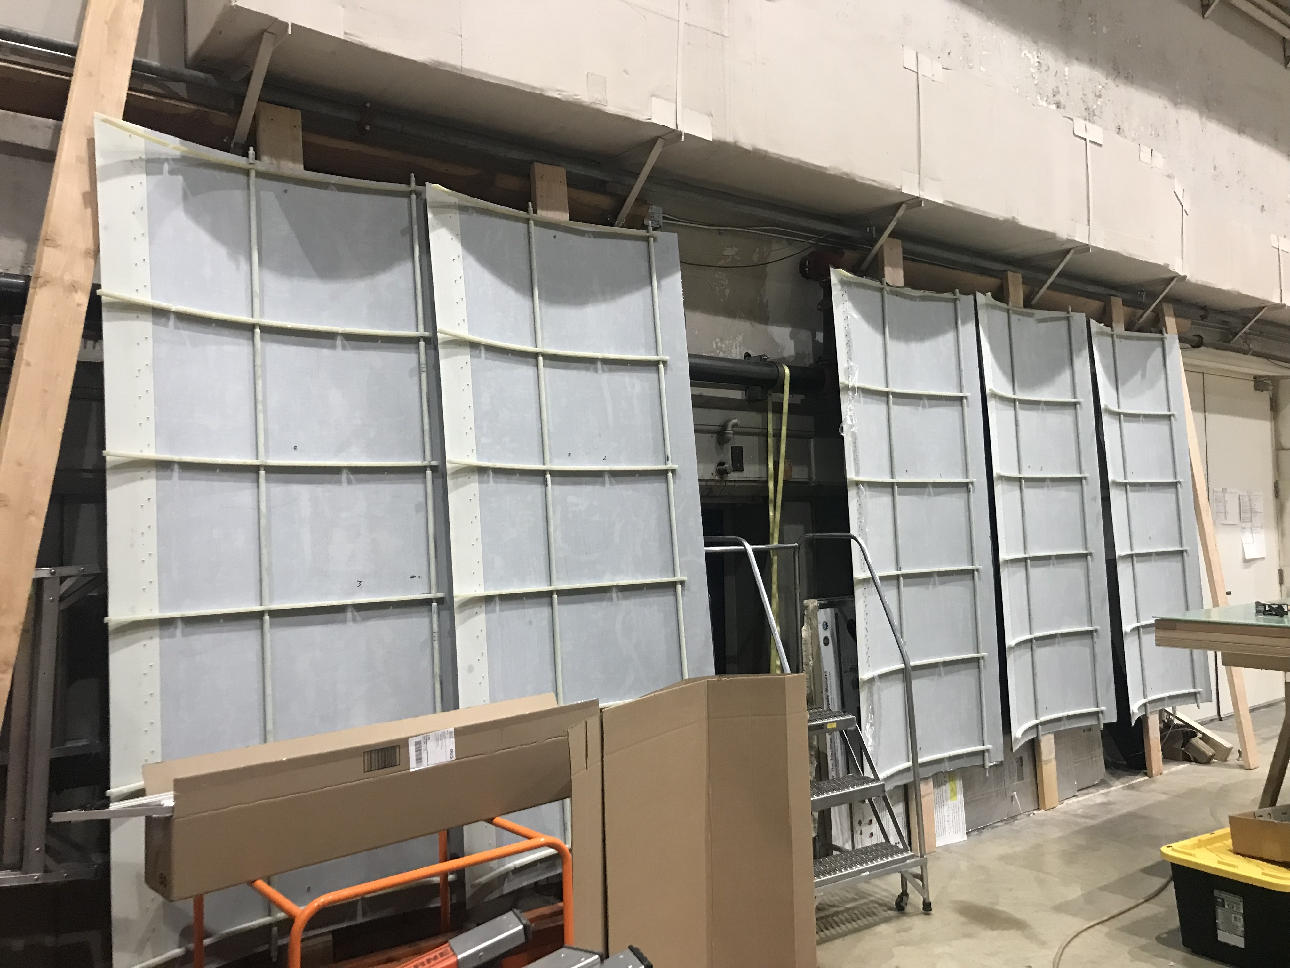
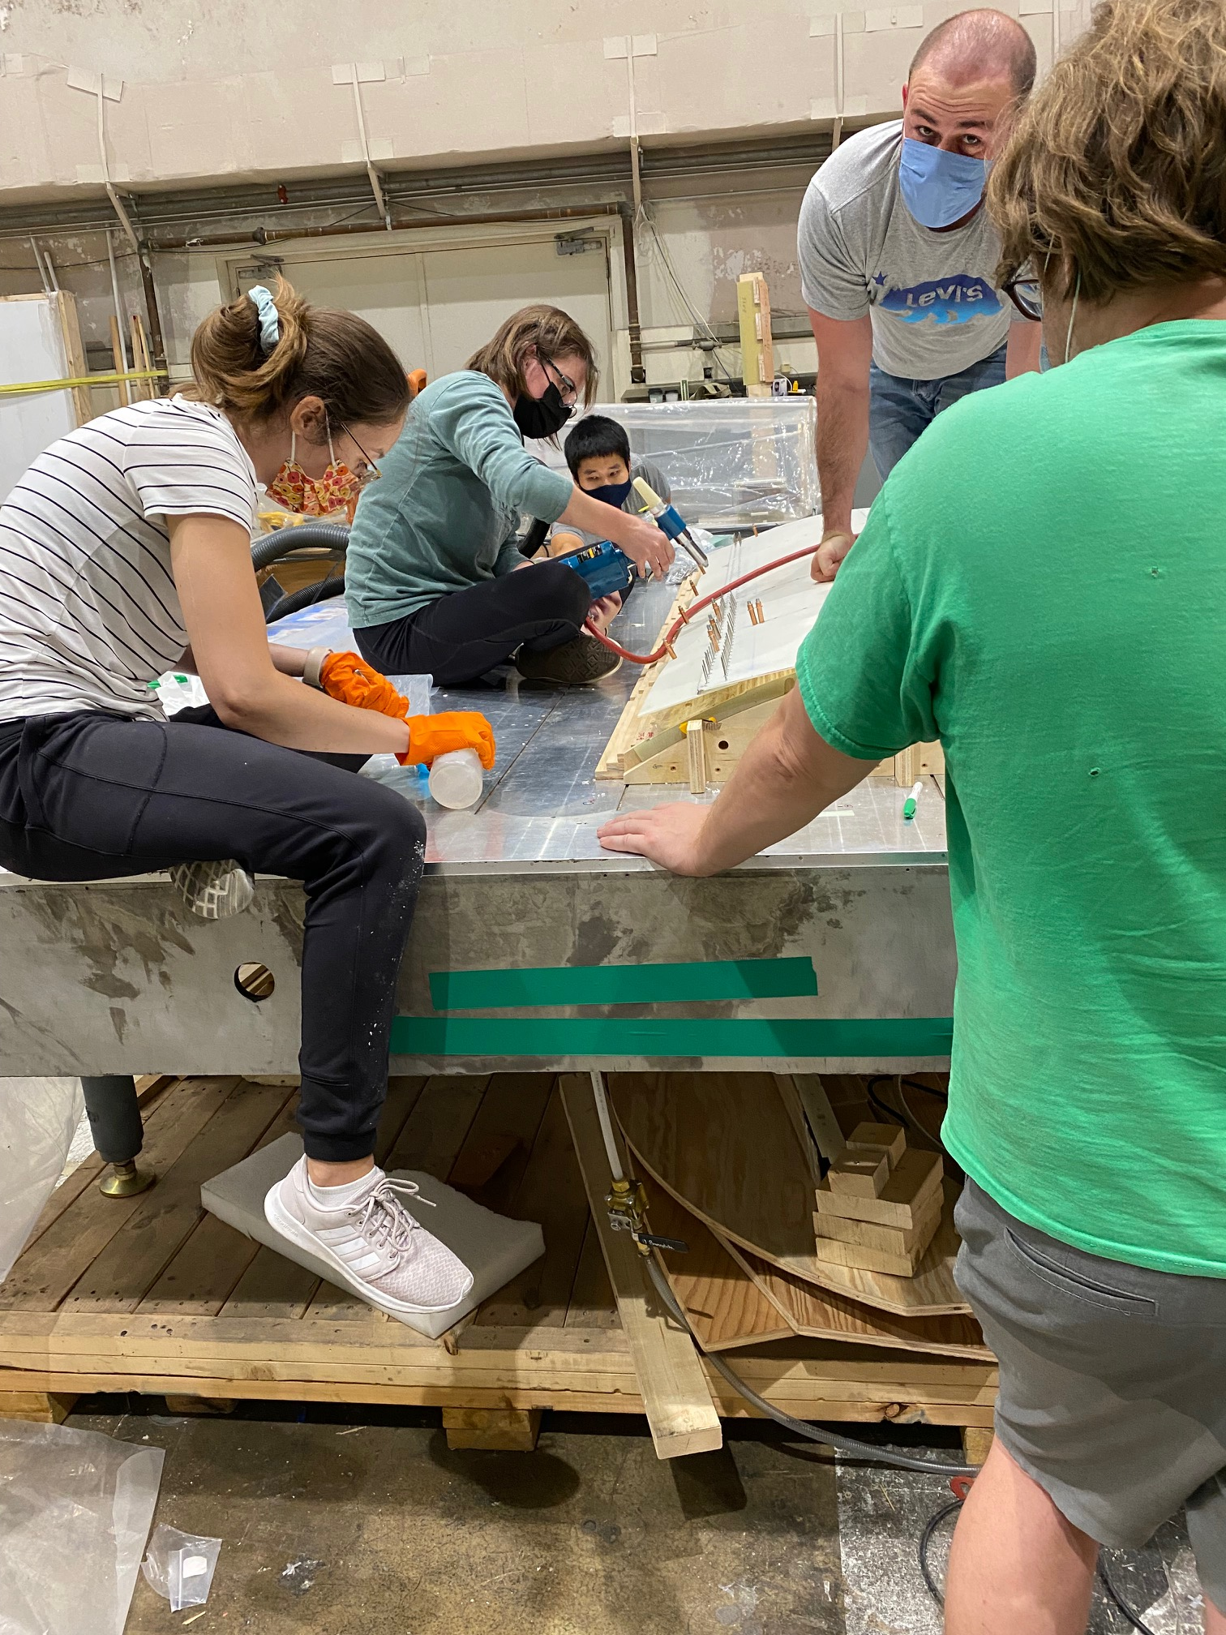
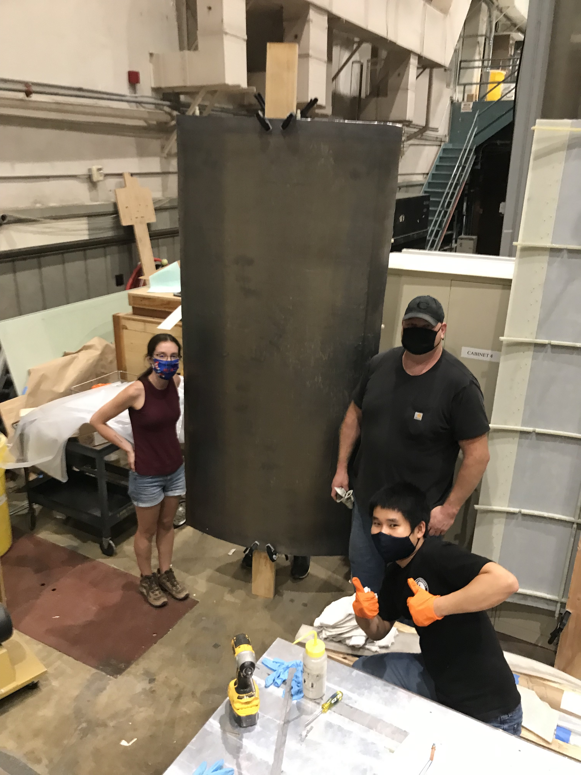
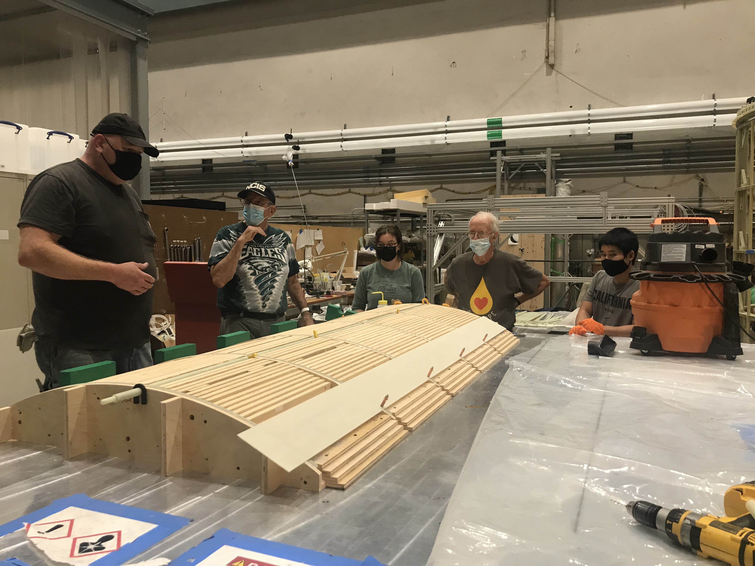
Timeline
Construction
Assemble G10 frame
Wind copper wire coil
Lead shielding panels
Copper-coated G10 panel
Metglas shield
Superconducting lead endcaps
Insert into cryovessel
Test vacuum and cooling systems
Characterization
Measurement campaign #1
Remove magnet and make any required fixes
Measurement campaign #2
Pack and Ship to Oakridge
Superconducting Lead Panels
Cylindrical shield of 0.8mm thick high-purity lead
Constructed in 6 separate panels
Wrapped around the outside of the magnet coil
Purpose: shield from external time-varying fields
Shielding is due to the Meissner Effect when the lead goes superconducting
External flux is expelled from the interior of the superconductor
DONE
DONE
Notes:
We constructed the six panels in September

Slide 12
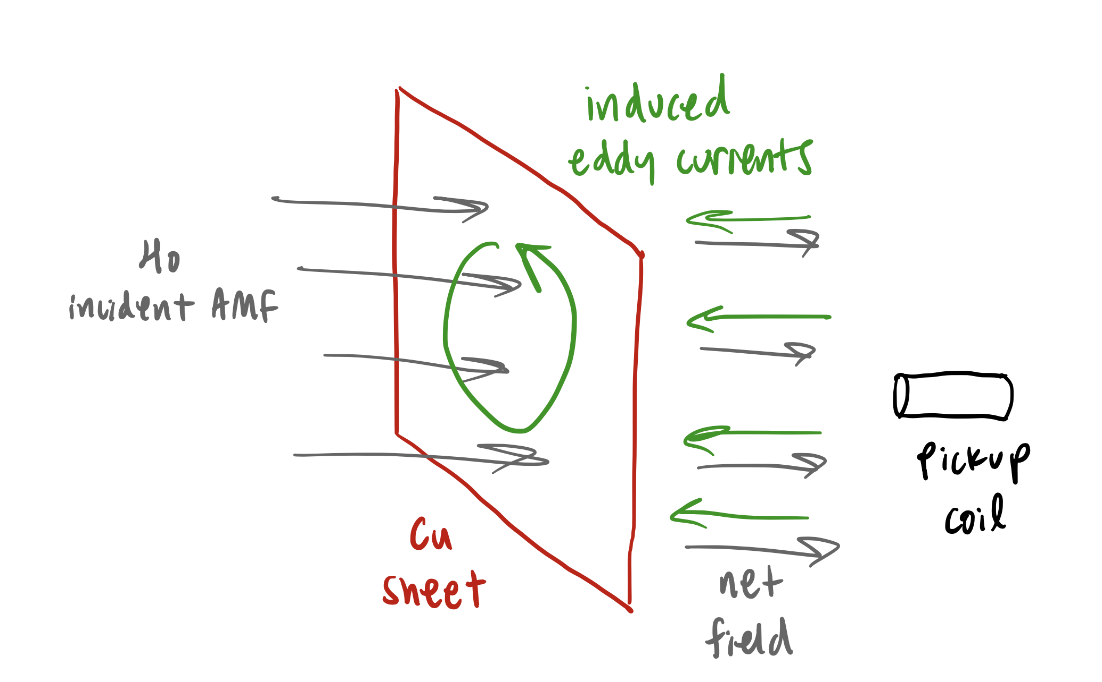
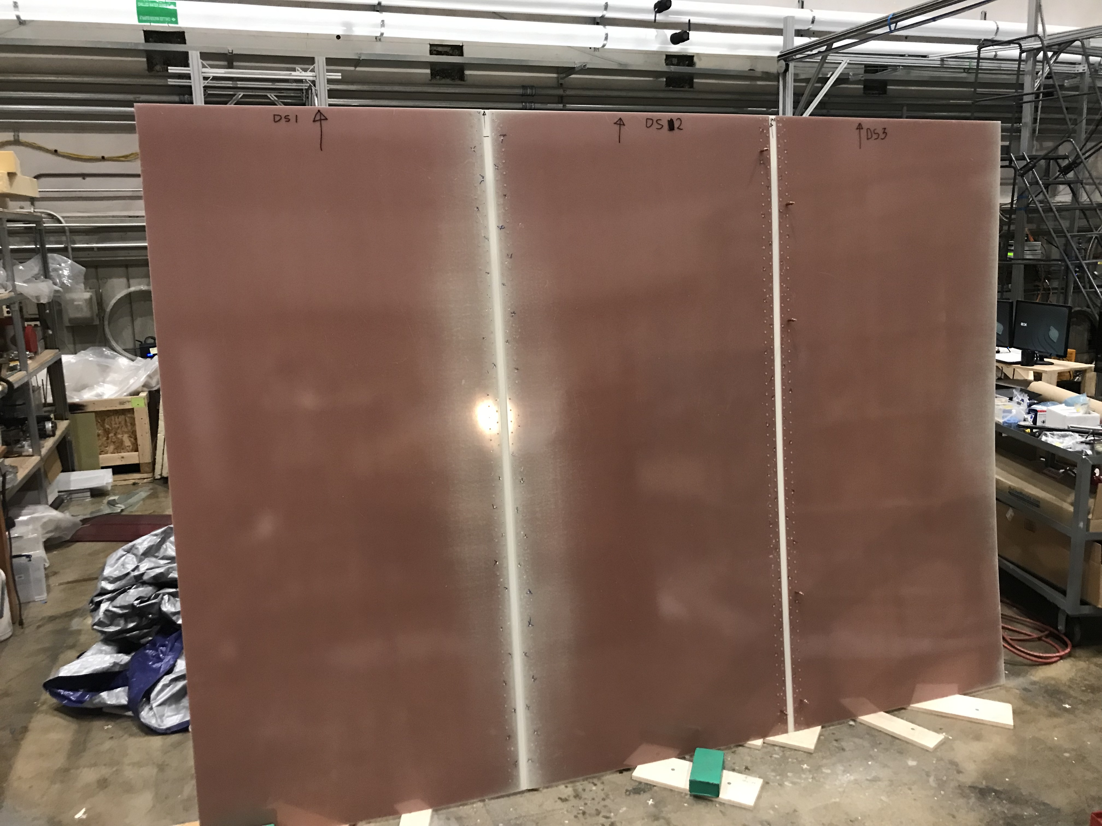
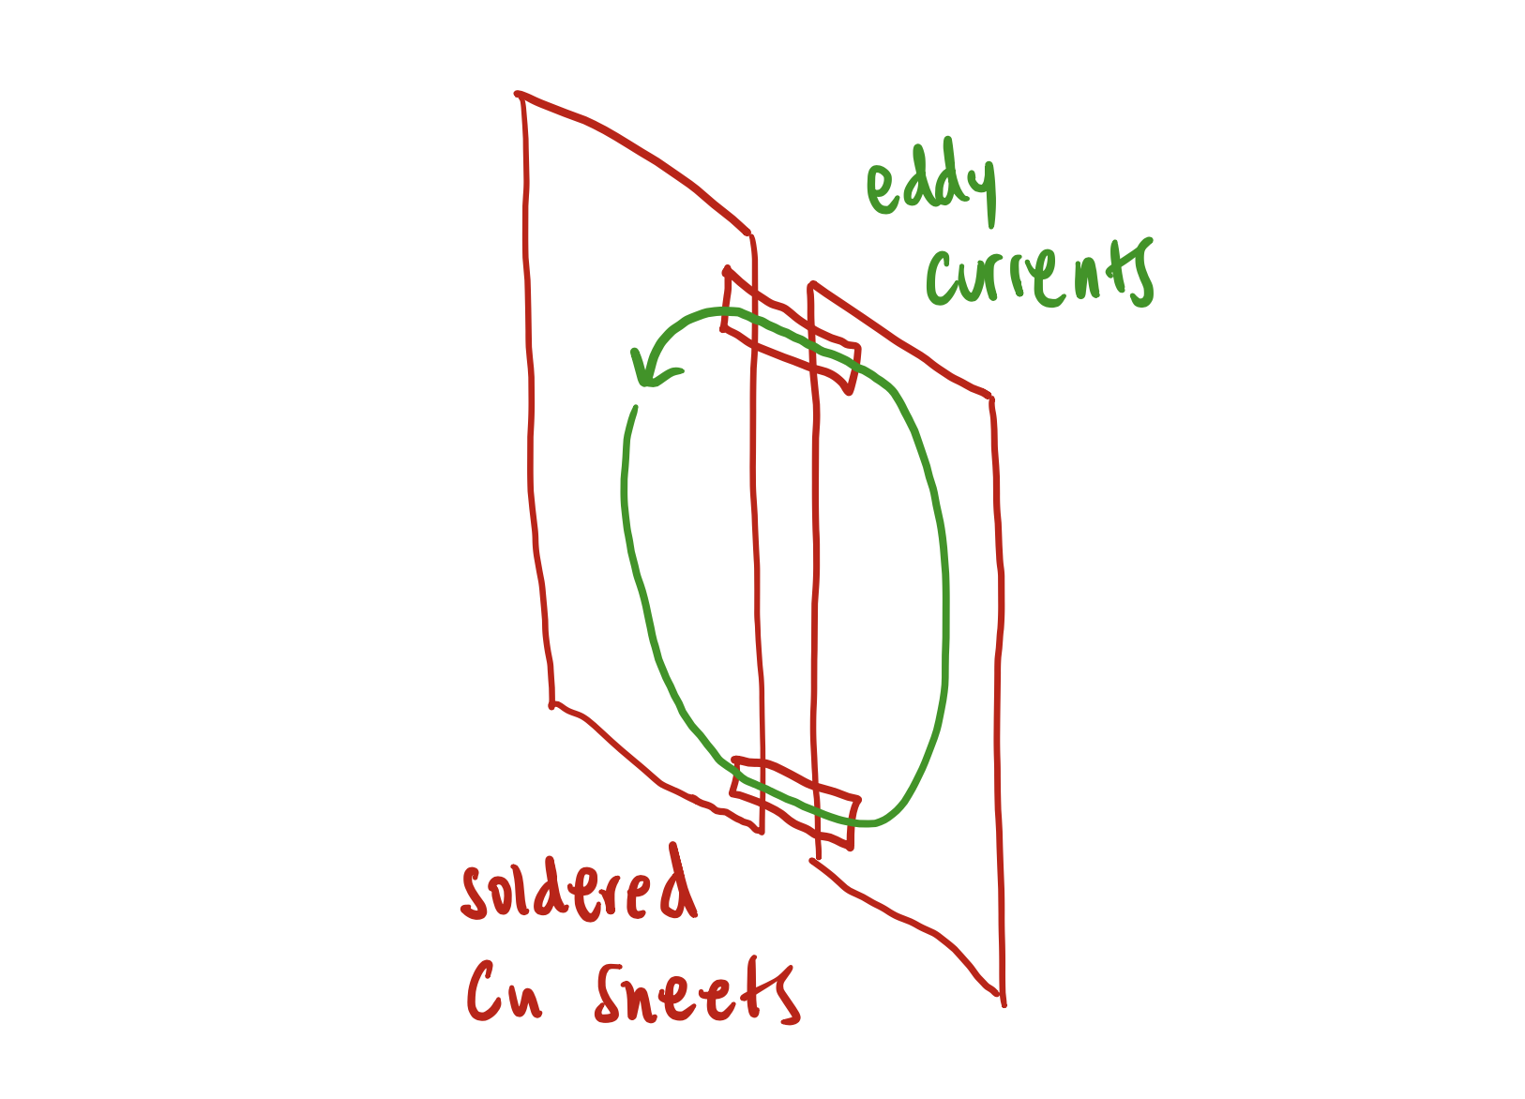
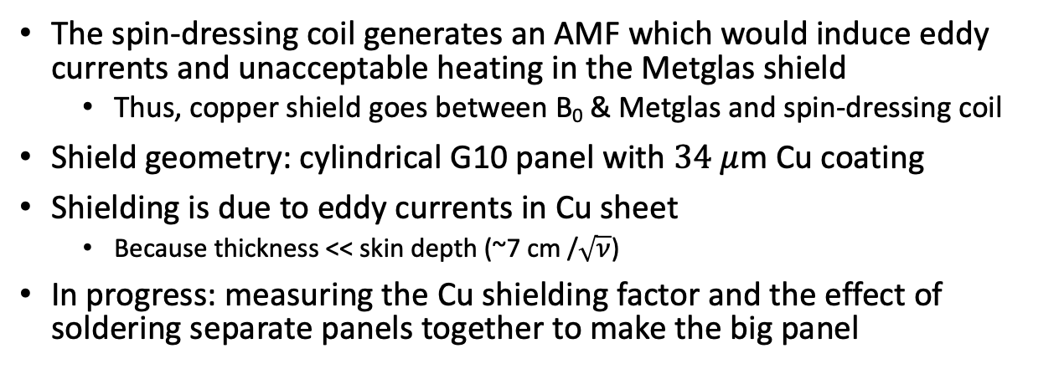
Timeline
Construction
Assemble G10 frame
Wind copper wire coil
Lead shielding panels
Copper-coated G10 panel
Metglas shield
Superconducting lead endcaps
Insert into cryovessel
Test vacuum and cooling systems
Characterization
Measurement campaign #1
Remove magnet and make any required fixes
Measurement campaign #2
Pack and Ship to Oakridge
Copper Shield
The spin-dressing coil generates an AMF which would induce eddy currents and unacceptable heating in the Metglas shield
Thus, copper shield goes between B₀ & Metglas and spin-dressing coil
Shield geometry: cylindrical G10 panel with $34 μ$m Cu coating
Shielding is due to eddy currents in Cu sheet
Because thickness << skin depth (~7 cm /$\sqrt{ν}$)
In progress: measuring the Cu shielding factor and the effect of soldering separate panels together to make the big panel
DONE
DONE
DONE
Notes:
Gap because commercial copper-clad G10 sheets don’t come in the size we need
We soldered copper foil to connect the gap
Previous models and simulations reveal that the majority of the shielding comes from the eddy currents with the greatest diameter and therefore the greatest flux.
Thus, just the top and bottom 10 inches is suffiecint for 95-99% of shielding

Slide 13
Timeline
Construction
Assemble G10 frame
Wind copper wire coil
Lead shielding panels
Copper-coated G10 panel
Metglas shield
Superconducting lead endcaps
Insert into cryovessel
Test vacuum and cooling systems
Characterization
Measurement campaign #1
Remove magnet and make any required fixes
Measurement campaign #2
Pack and Ship to Oakridge
Metglas Shield
Flux return just outside the B₀ coil
Made of Metglas 2826M, an amorphous material which retains its high permeability at low temperatures
Purpose: improve B₀ field uniformity
Mitigates errors in wire placement
Reduces field distortions due to superconducting lead shielding layer
DONE
DONE
DONE
IN PROGRESS
Notes:
Imposes a boundary condition s.t. that the field lines terminate perpendicular to the shield
--helps improve uniformity
--”sucks in” the field lines

Slide 14
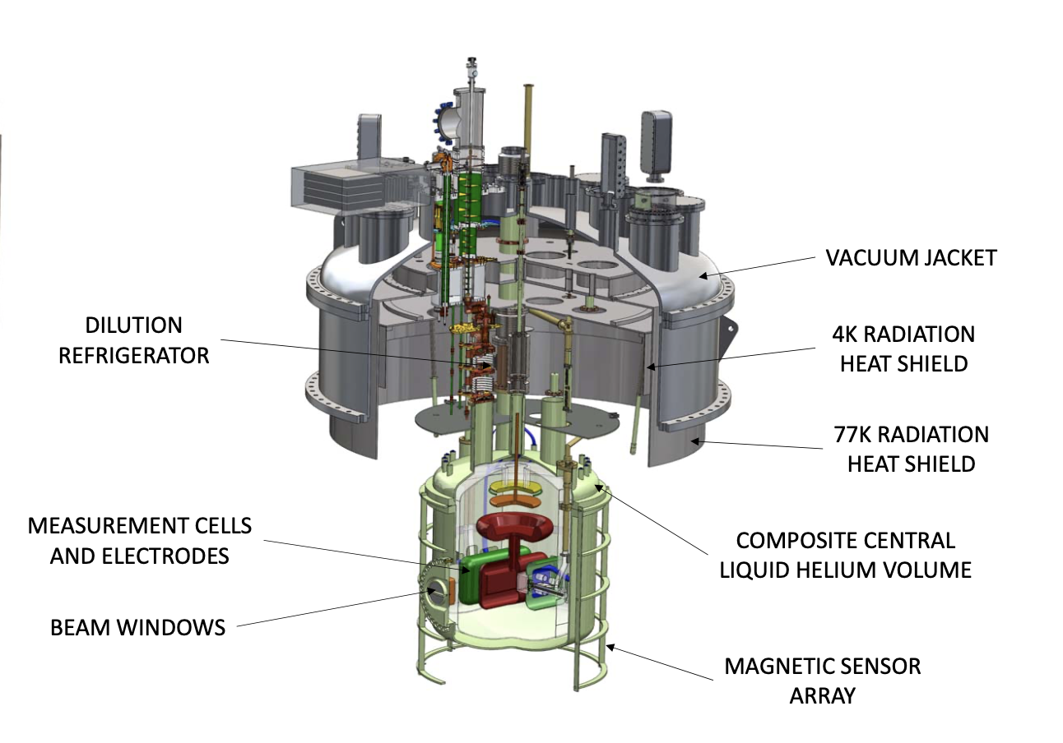
Timeline
Construction
Assemble G10 frame
Wind copper wire coil
Lead shielding panels
Copper-coated G10 panel
Metglas shield
Superconducting lead endcaps
Insert into cryovessel
Test vacuum and cooling systems
Characterization
Measurement campaign #1
Remove magnet and make any required fixes
Measurement campaign #2
Pack and Ship to Oakridge
Superconducting Lead Endcaps
The lead shield is essentially a closed cylinder, capped on both ends
Purpose: Ensure uniformity of B₀ field
Field lines will run parallel to the superconductor
Essentially removes fringe fields so the coil behaves as if it’s infinite
Still designing and constructing some components—installation by February
DONE
DONE
DONE
IN PROGRESS
JANUARY
TOP ENDCAP

Slide 15
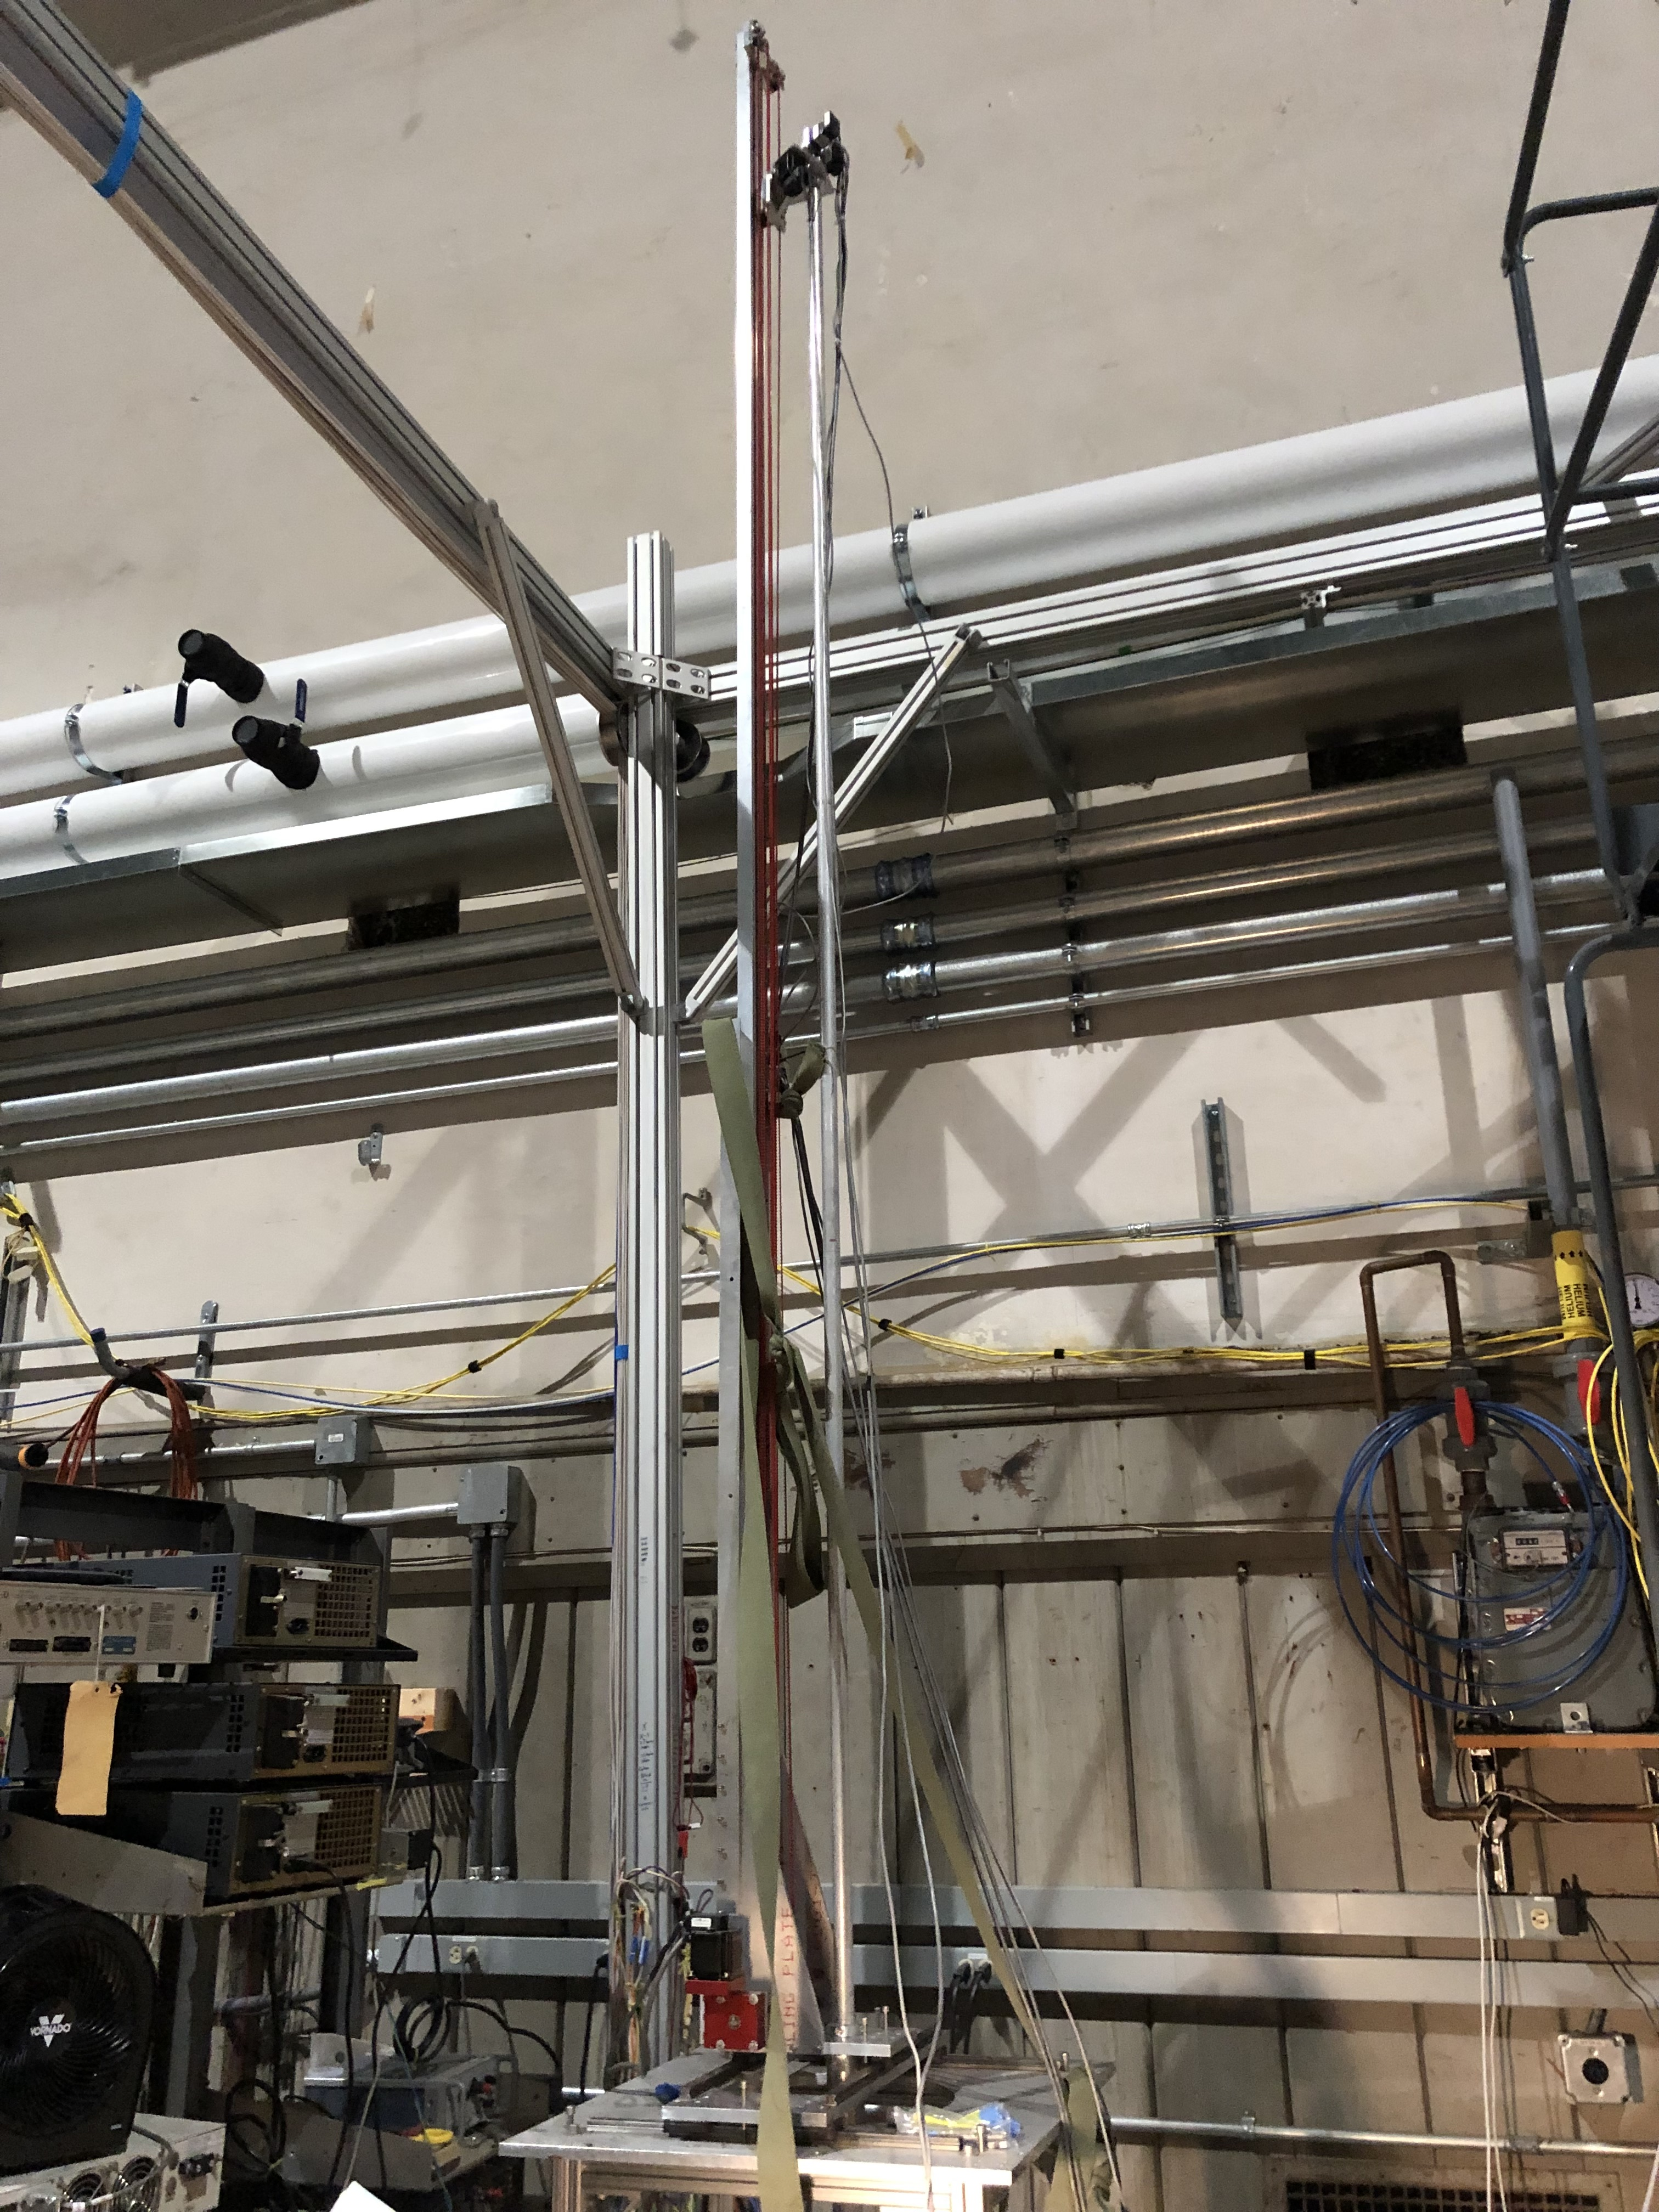
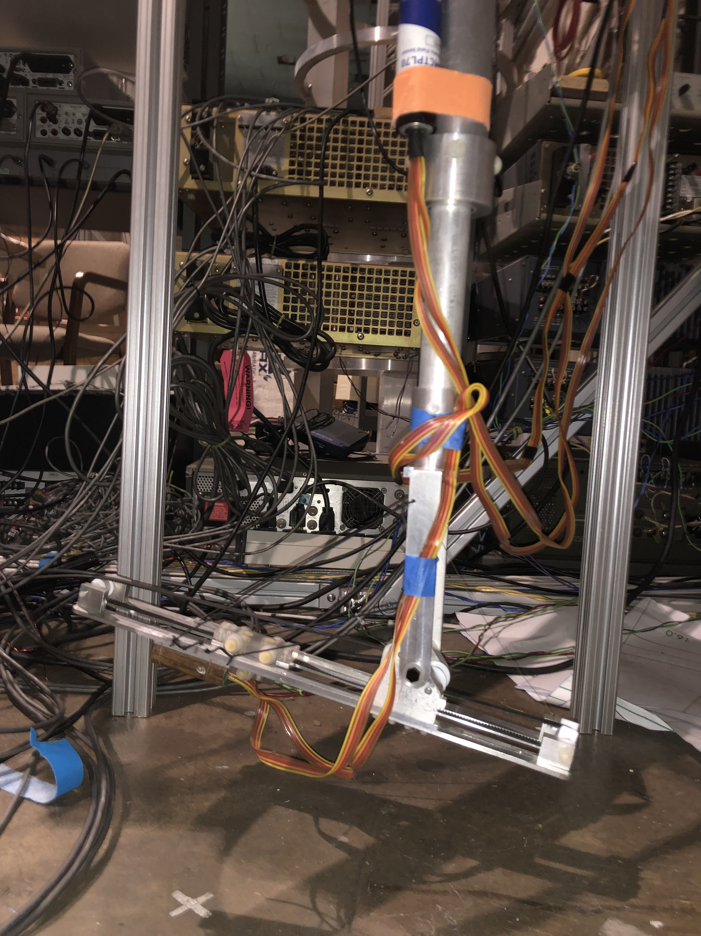
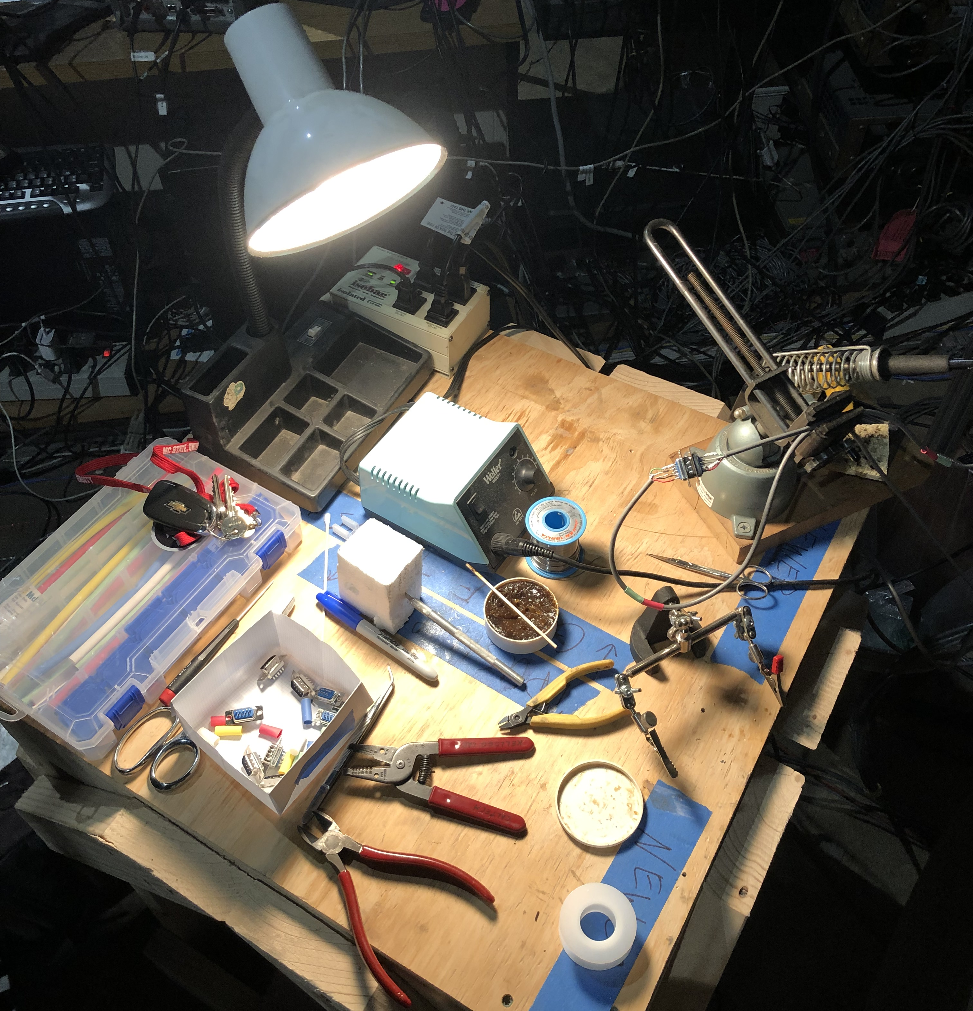
Timeline
Construction
Assemble G10 frame
Wind copper wire coil
Lead shielding panels
Copper-coated G10 panel
Metglas shield
Superconducting lead endcaps
Insert into cryo-vessel
Test vacuum and cooling systems
Characterization
Measurement campaign #1
Remove magnet and make any required fixes
Measurement campaign #2
Pack and Ship to Oakridge
Measurements
Measure the three field components at many points in the interior
Then reconstruct the internal field with Maxwell-guided fits
Use a robotic probe-arm with x,y,z direction magnetometers
Can insert the probe into the “warm bore” which provides access from the outside
Will have to characterize and correct for background fields
Perform 1-2 rounds of measurements with full cooldown
Goal is to ship to Oakridge in March-May 2022
DONE
DONE
DONE
IN PROGRESS
JANUARY
FEBRUARY?
JANUARY

Slide 16
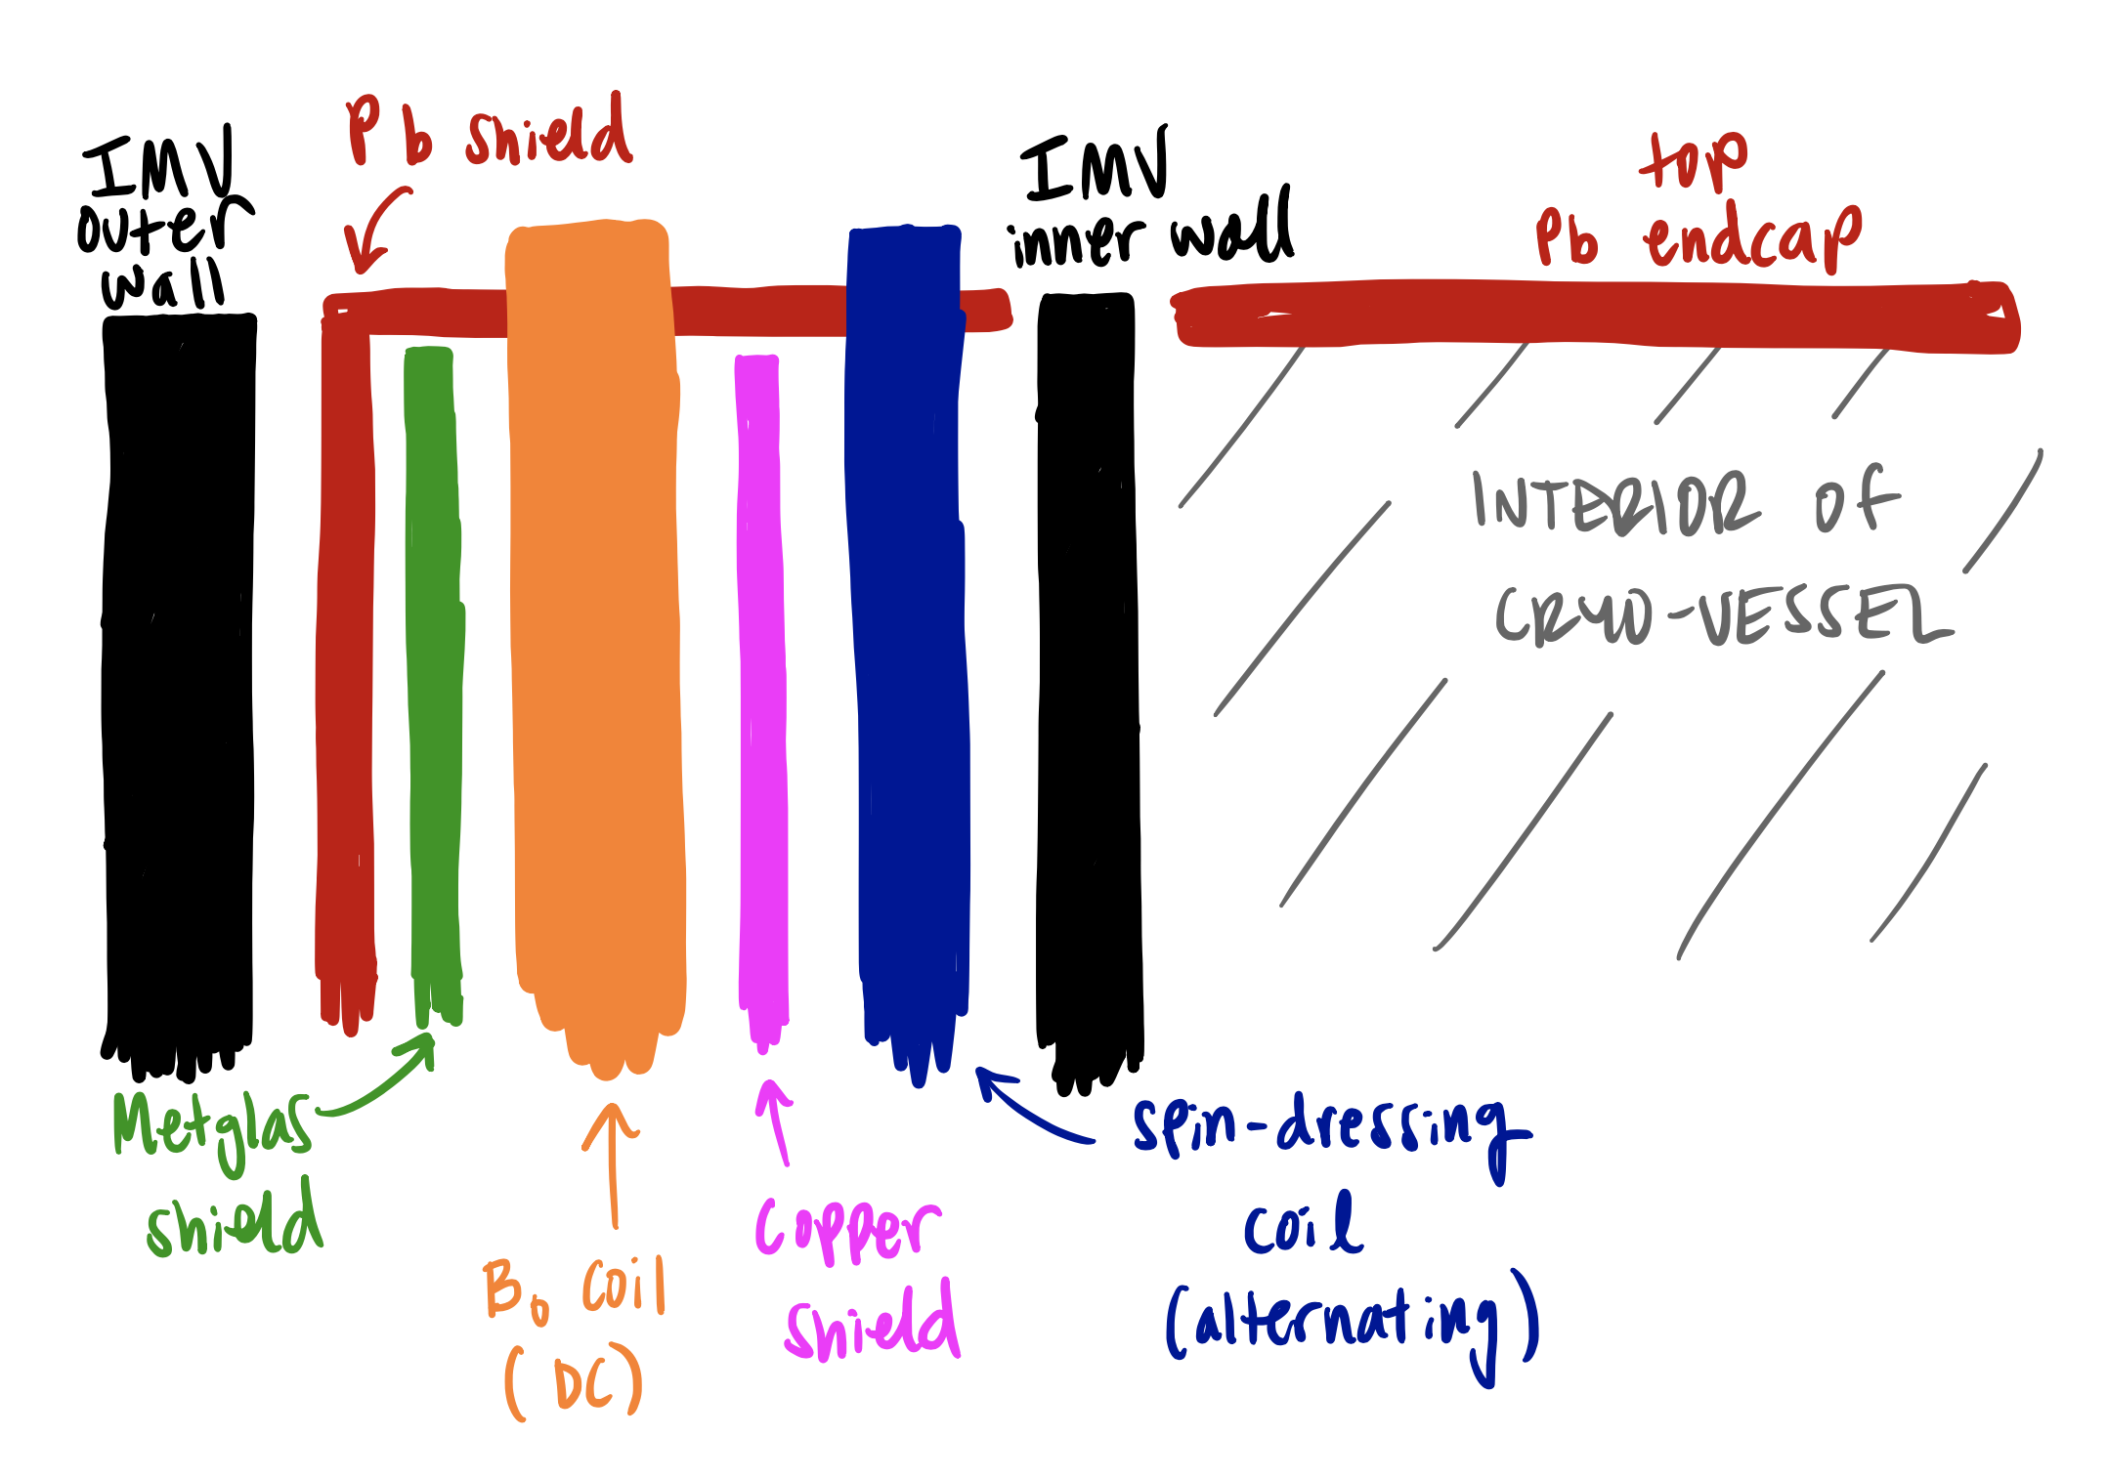
Timeline
Construction
Assemble G10 frame
Wind copper wire coil
Lead shielding panels
Copper-coated G10 panel
Metglas shield
Superconducting lead endcaps
Insert into cryovessel
Test vacuum and cooling systems
Characterization
Measurement campaign #1
Remove magnet and make any required fixes
Measurement campaign #2
Pack and Ship to Oakridge—March - May
Summary
Driving goal of nEDM@SNS is to measure the neutron’s electric dipole moment with unprecedented precision
Searching for evidence of CP violating BSM physics
Caltech is developing the cryogenic system and B₀ magnet
Uniformity of the B₀ magnet is very important
Goal: < 5 ppm/cm
Accomplish this various layers of shielding
I will work on constructing the magnet and shielding and characterizing its field
DONE
DONE
DONE
IN PROGRESS
JANUARY
FEBRUARY?
JANUARY
JANUARY
FEBRUARY
MARCH

Slide 17
Ahmed et al. 2019, JINST

Slide 18
Ahmed et al. 2019, JINST

